Slide 1


npm-assignment
By : Shashikant Tanti

Slide 2
Content
Setup NODEjs environment in our machine and install the following packages as global packages - 1. Angular
2. React
3. Vue
4. Ionic

Slide 3
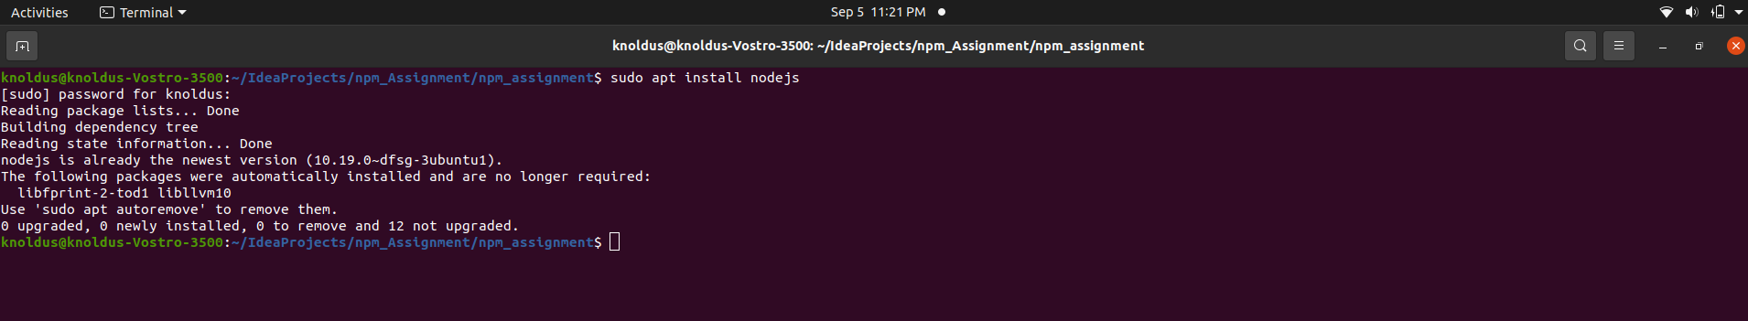
Setup NODEjs environment in our machine and install the
“Angular – packages” as global packages :-
(a). First we have to install nodejs in our sysem using command
: $ sudo apt install nodes

Slide 4
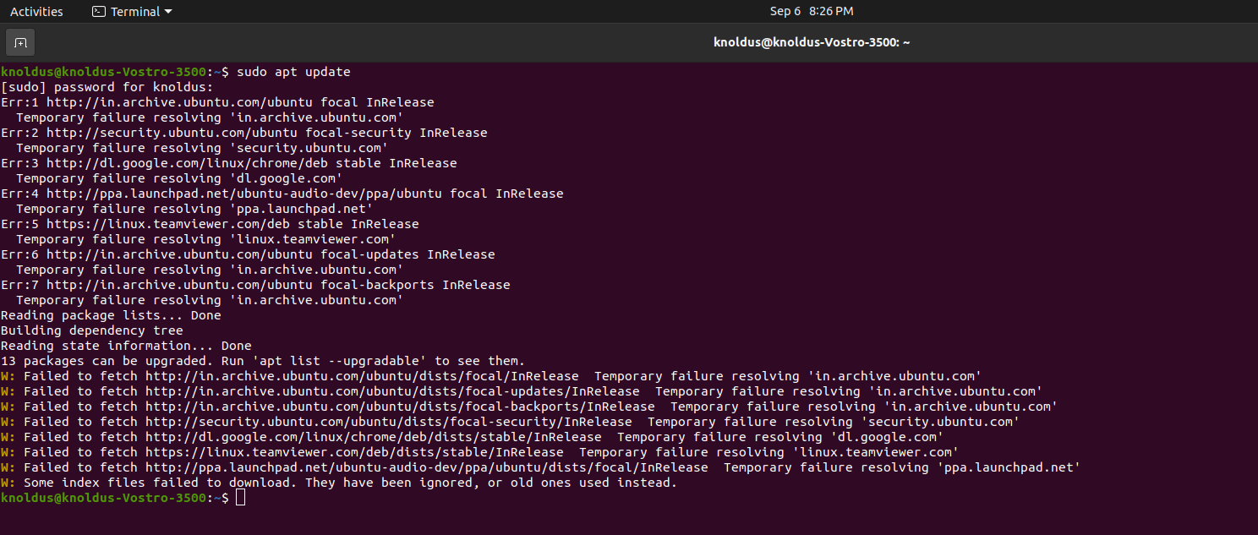
(b) Run following command to check updated node version:-
$ sudo apt update

Slide 5
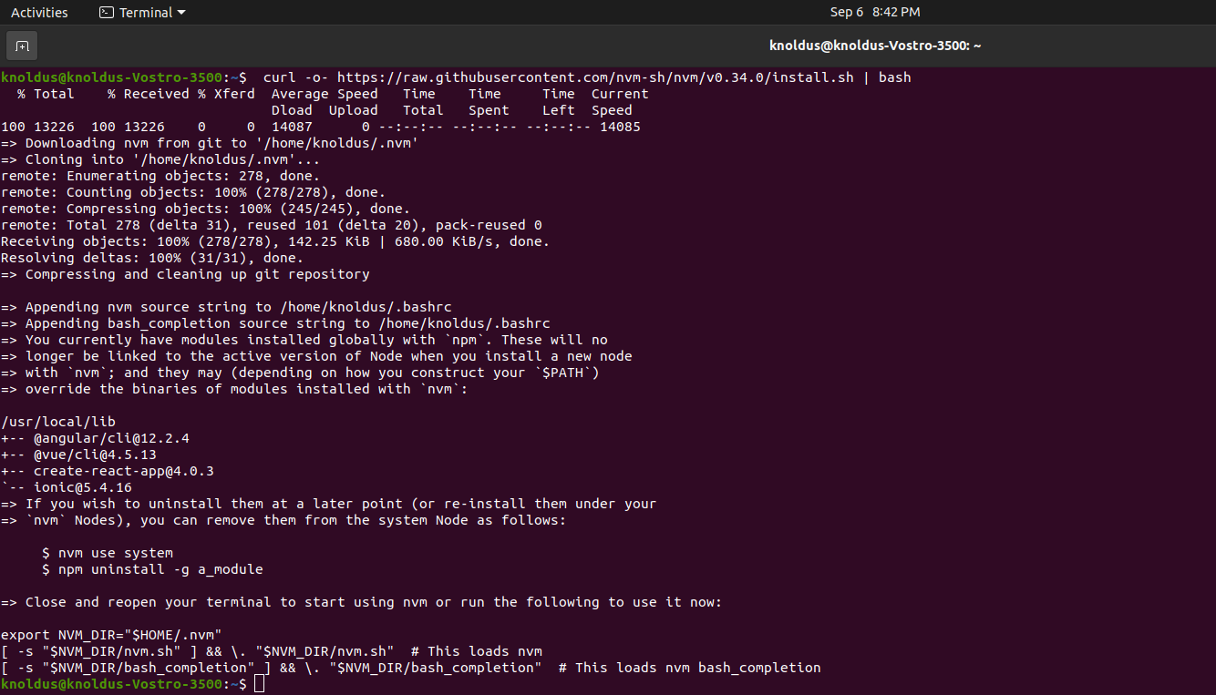
(c) Now ,We can update node version using command:-
curl –o- https://raw.githubusercontent.com/nvm-sh/nvm/v0.34./install.sh | bash

Slide 6
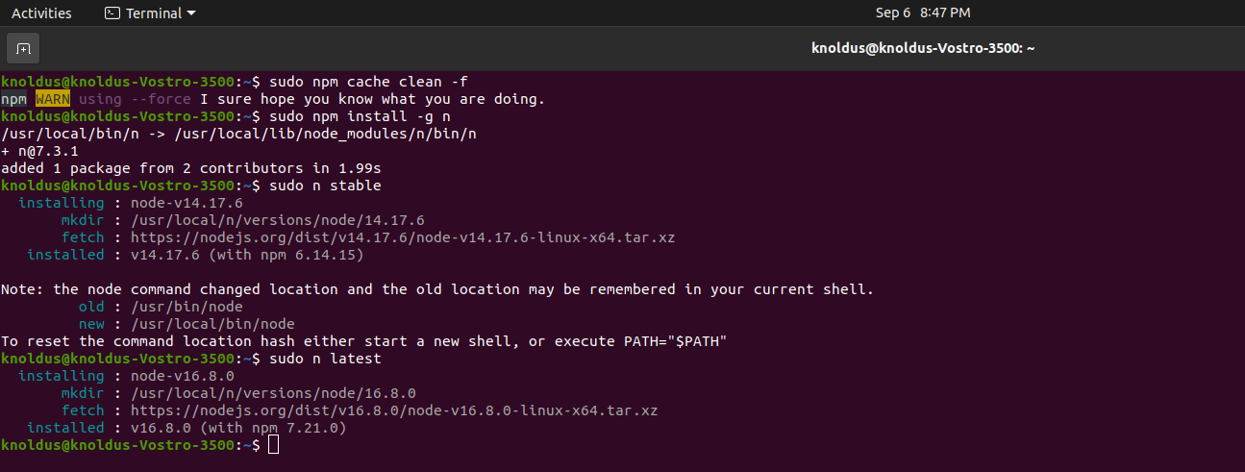
(d) This step show the node version installed in machine with command :
$ sudo n stable
$ sudo n latest

Slide 7
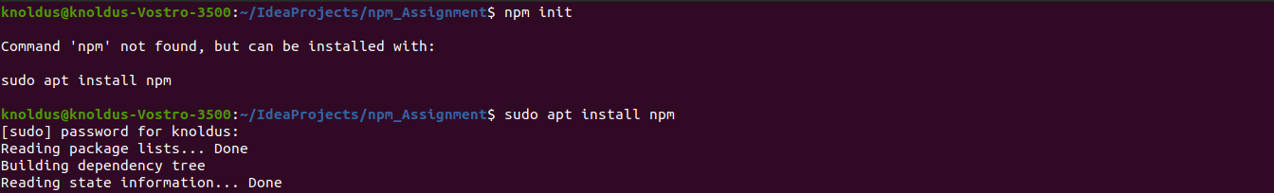
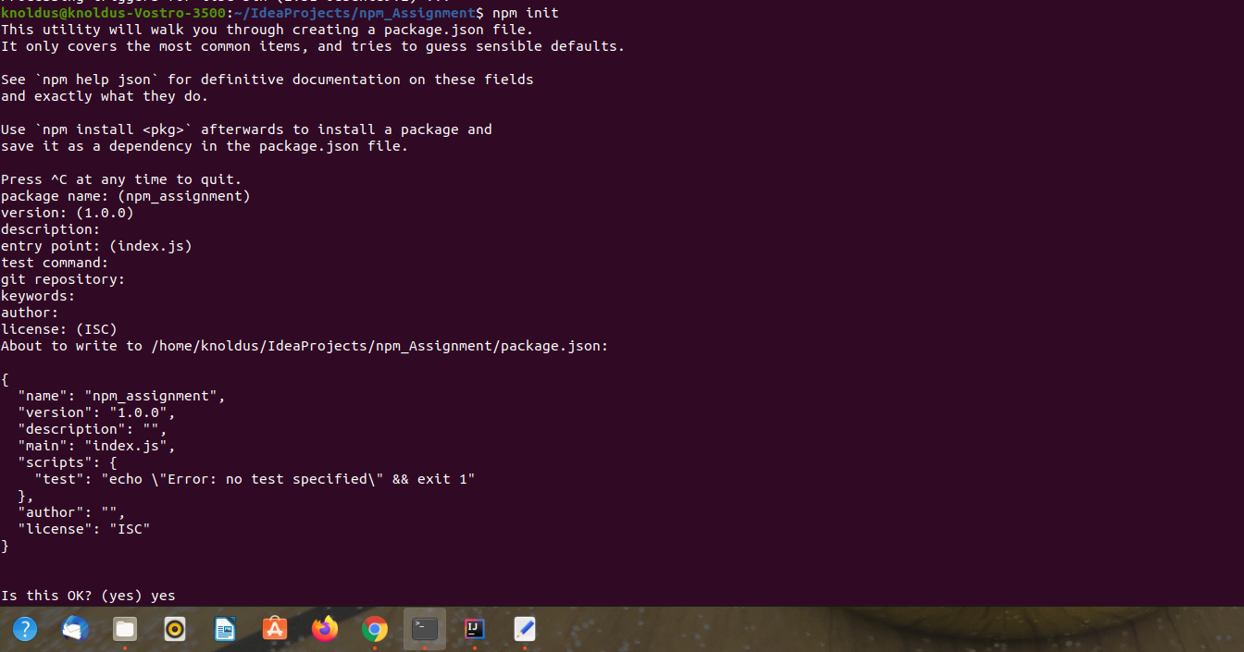
(e) Here Angular-JS installation start, first we have to install npm and start npm using followings command:

Slide 8
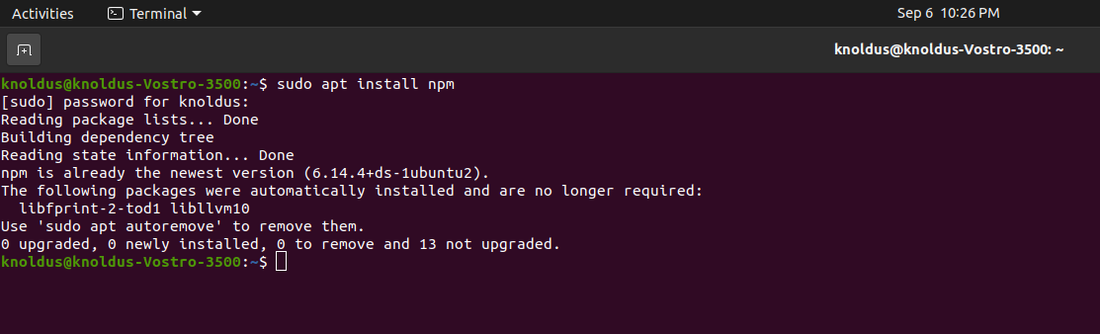

Here Angular-JS installation start, first we have to install npm and start npm using followings command:
$ sudo apt install npm
After installation of npm we have to start npm using followings command:
$ npm start

Slide 9
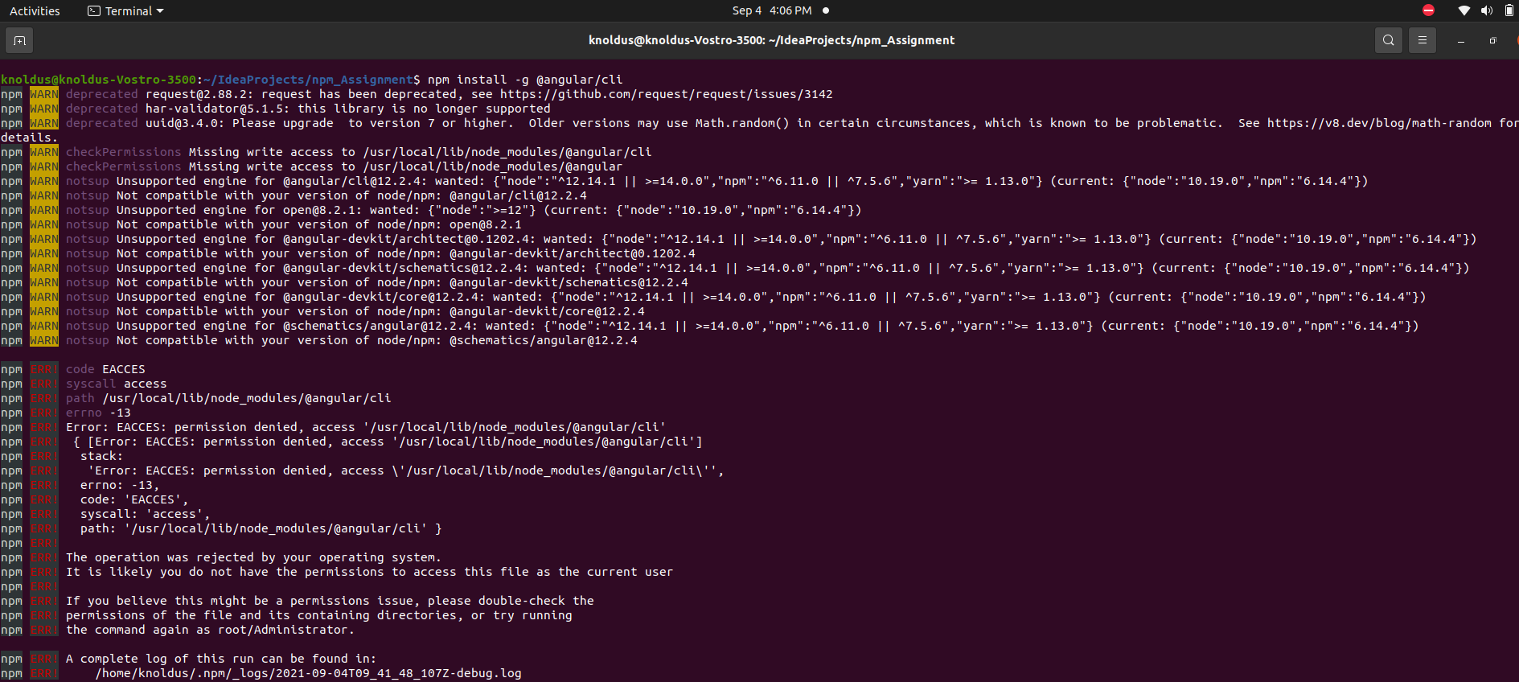
Step- 1: in this step we install AngularJS version with simply using following command:-
$ sudo npm install –g @angular/cli

Slide 10
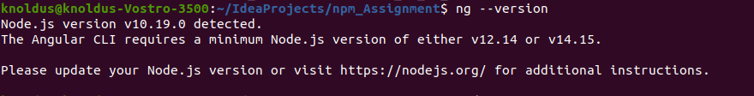
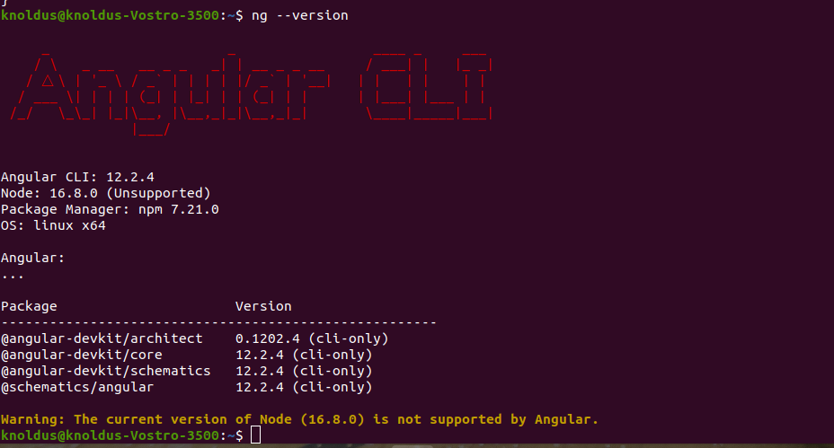
Step 1.(a): in this step we confirm the Angular installation with simply run command:-
$ ng –version or $ ng v

Slide 11
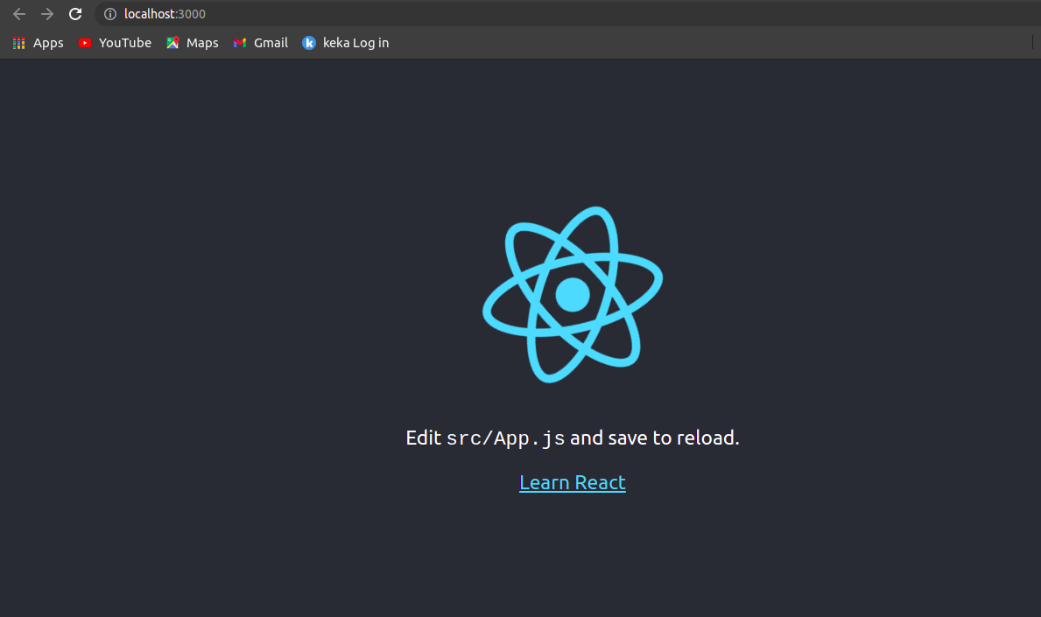
1.(b) In this step we simply run the React-app in browser as localhost & we get following:

Slide 12
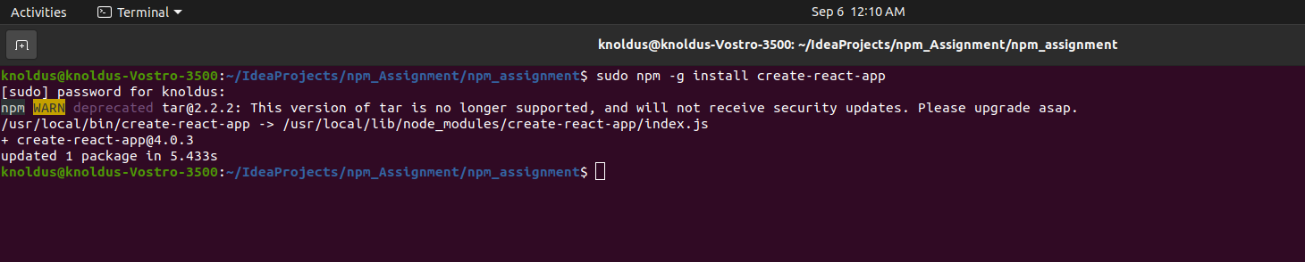
Step- 2: in this step we simply install create-react-app using following command:-
$ sudo npm –g install create-react-app

Slide 13
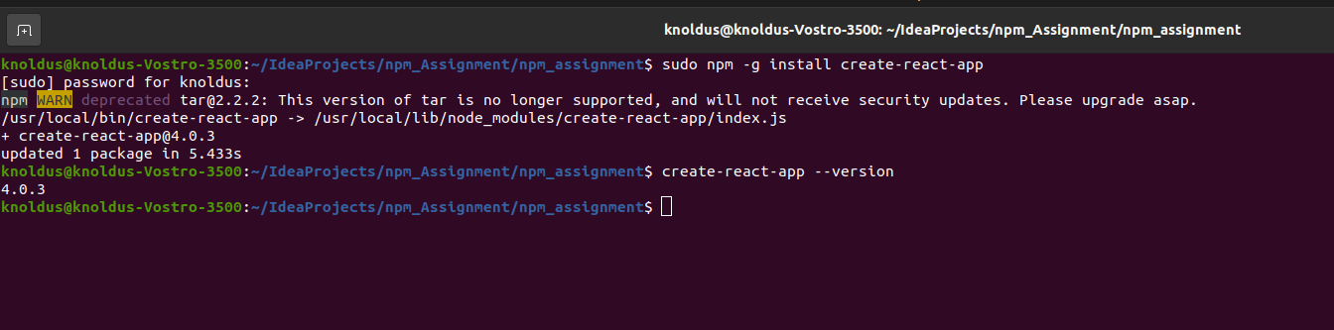
2.(a) In this stage we check the installed create-react-app version using command:-
$ create-react-app --version

Slide 14
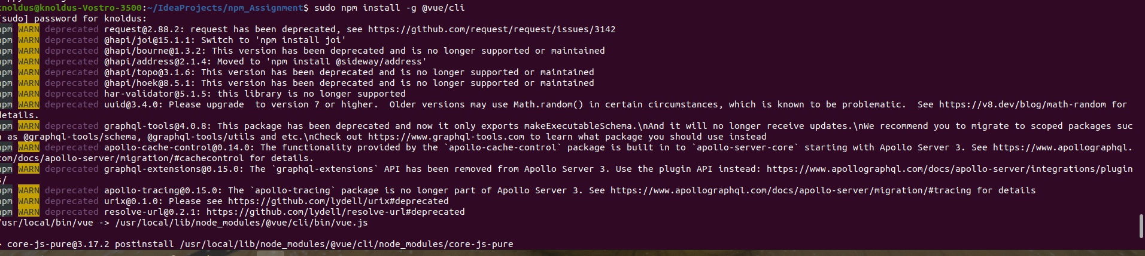
Step- 3: in this step we confirm the vue/cli version after installing it through following command:-
$ sudo npm install –g @vue/cli

Slide 15
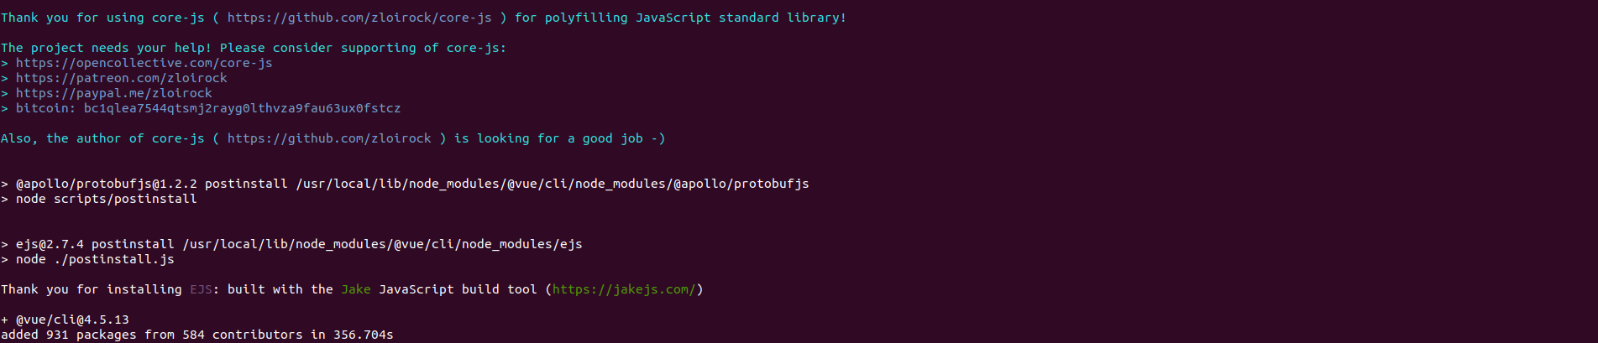
3(a).In this step it shows the installed / downloaded version of vue-cli in our machine :

Slide 16
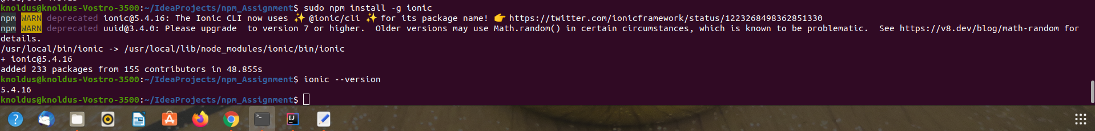
Step- 4: To install npm ionic version use following command:-
$ sudo npm install –g ionic
Also to check running ionic version use command
$ ionic --version

Slide 17

Thank You!

